Slide 1
Vertex AI: End2End
Developing and deployment of ML model in GCP
Tharun Mukka

Slide 2
Highlights
How to use GCP VertexAI
Model development
Model Deployment

Slide 3
Objective
Ingest and analyze a BigQuery dataset in AI Platform Notebooks
Understanding how to develop and deploy on GCP
To deploy a machine learning model so that it can be accessed anywhere or any application for making assumptions.

Slide 4
Procedure

Slide 5
Application Flow
GCP setup
Fetching data
Model building
Deploying Model
Test using End point

Slide 6
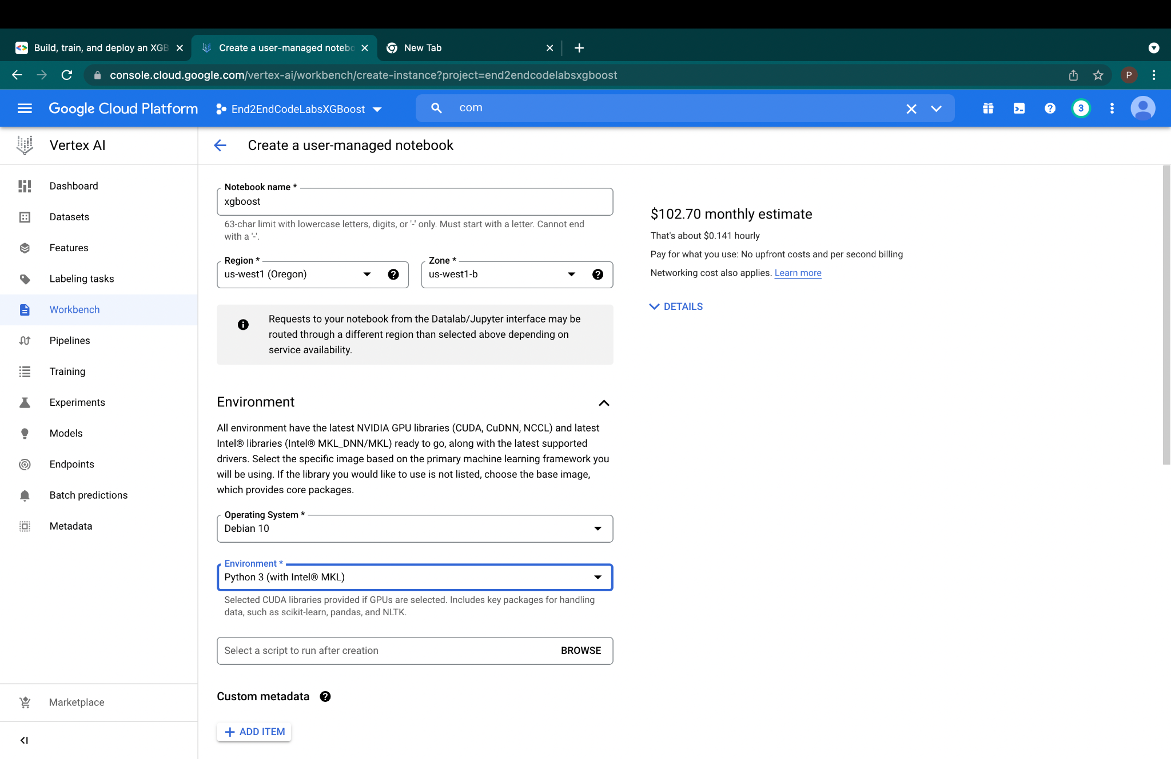
Setting up the environment

Slide 7
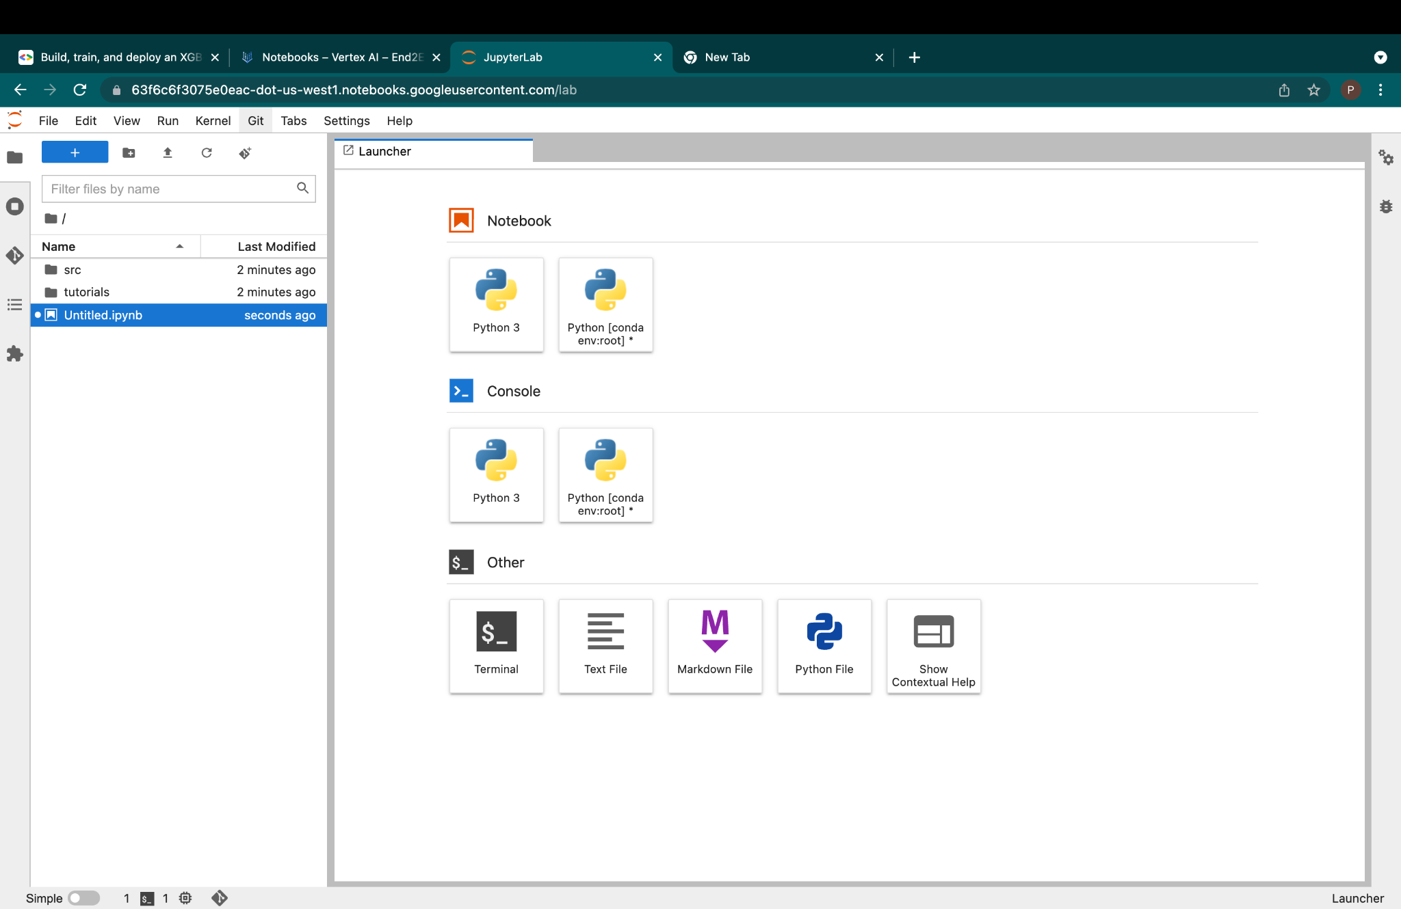
Select the Notebook

Slide 8
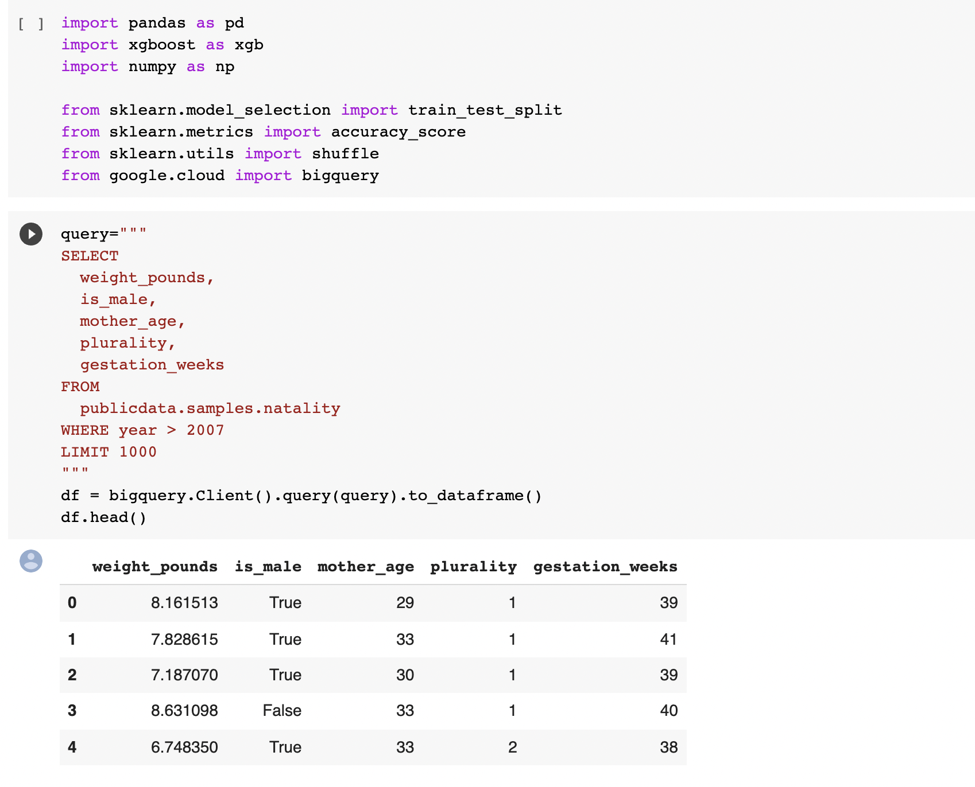
Packages and Data Fetch from Big Query

Slide 9
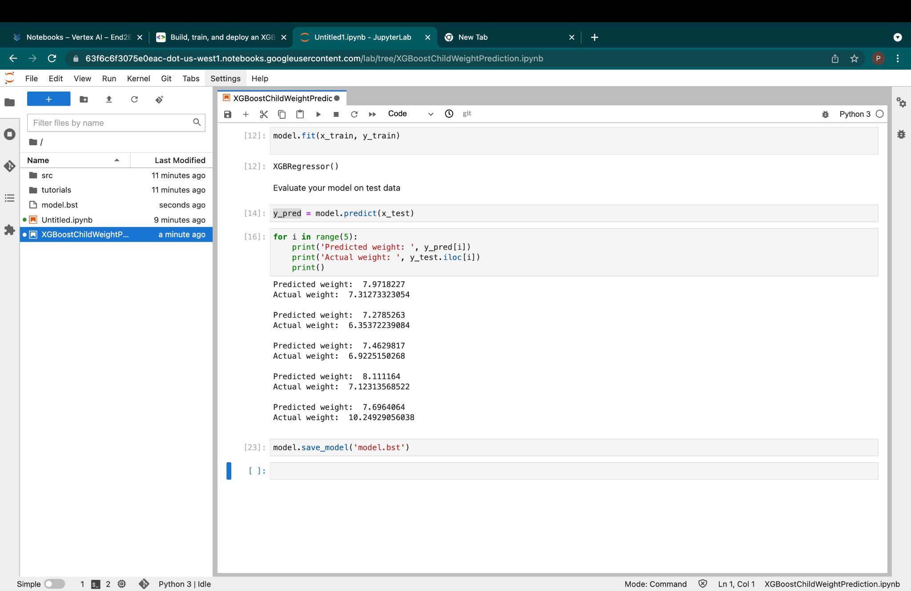
Saving the model

Slide 10
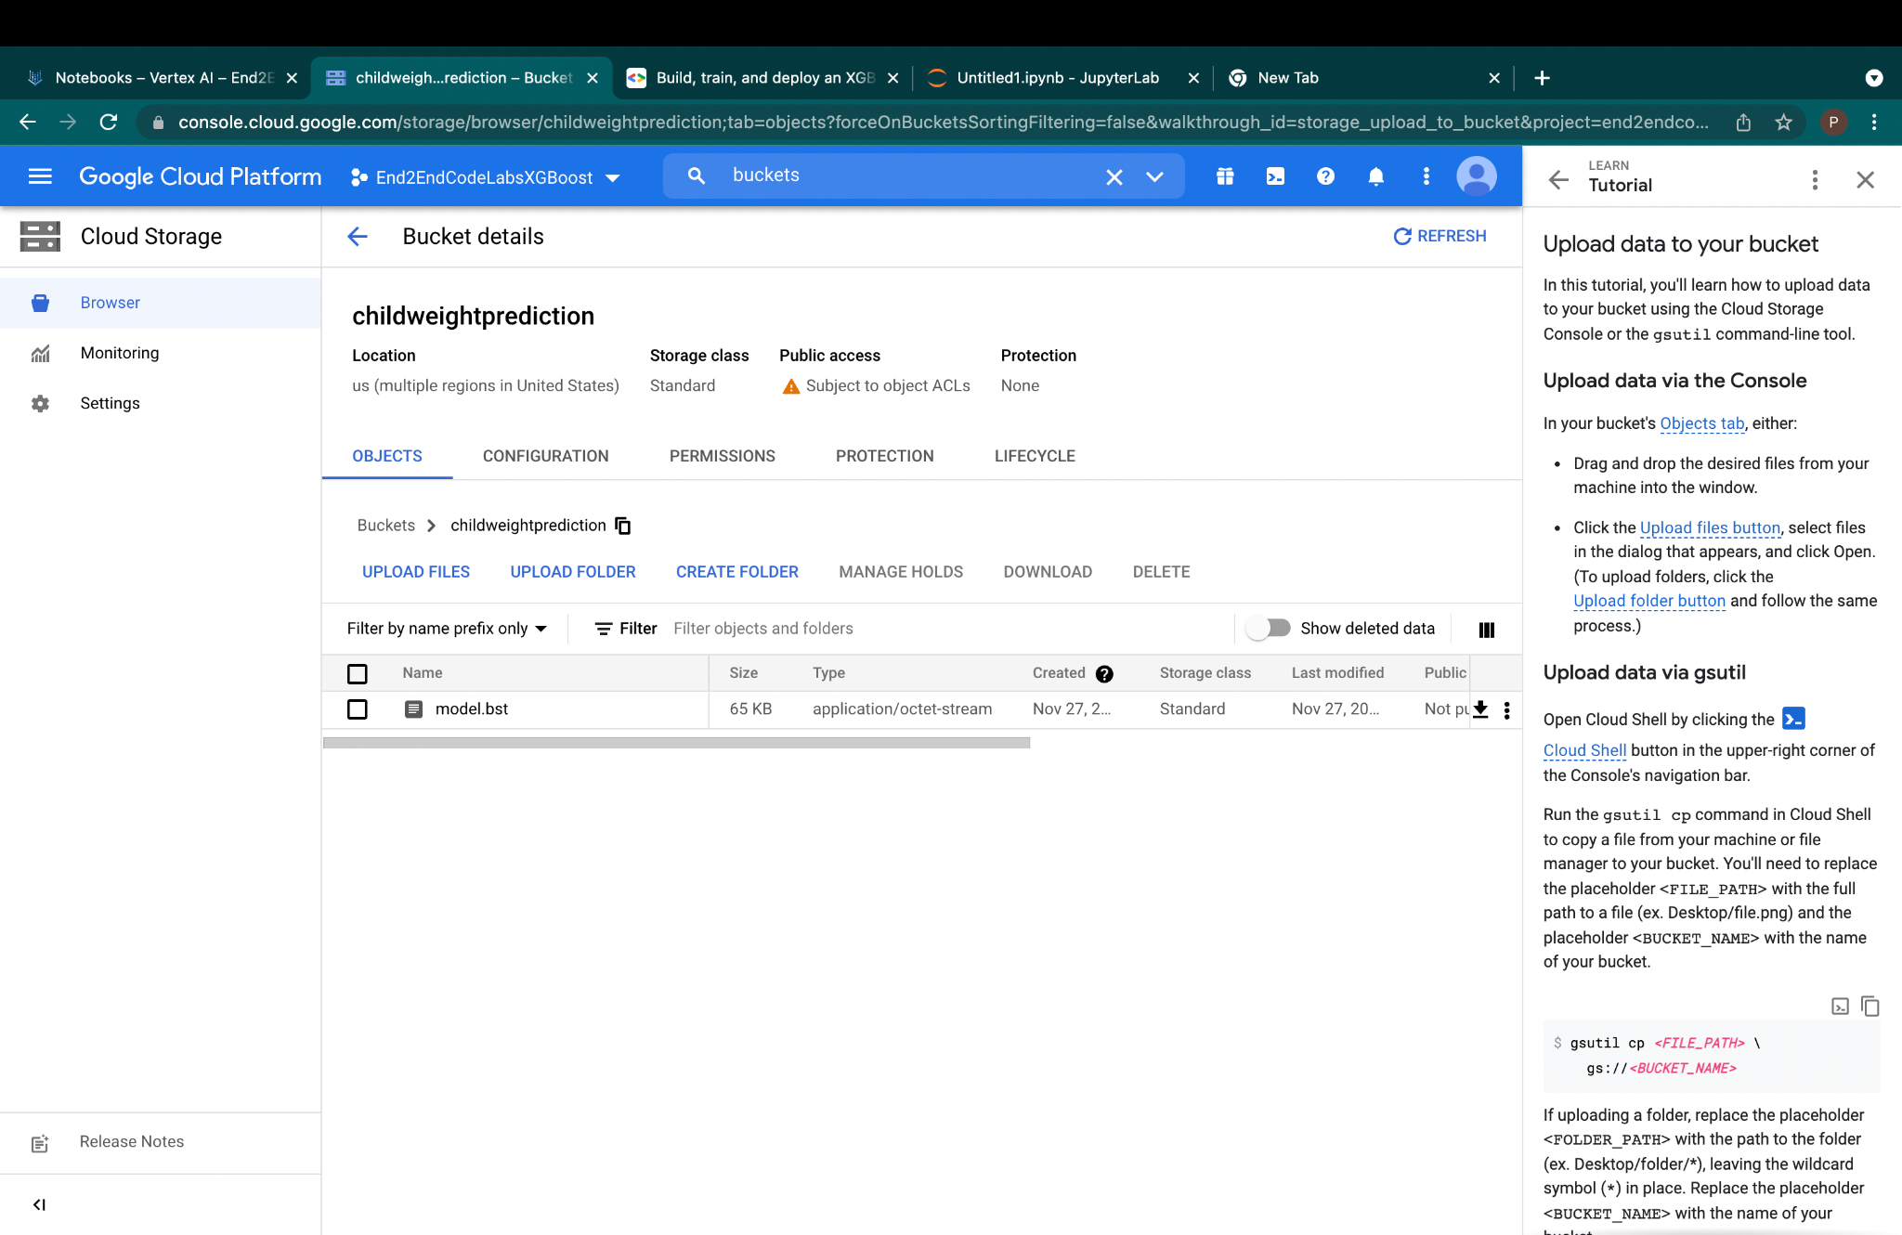
contd:

Slide 11
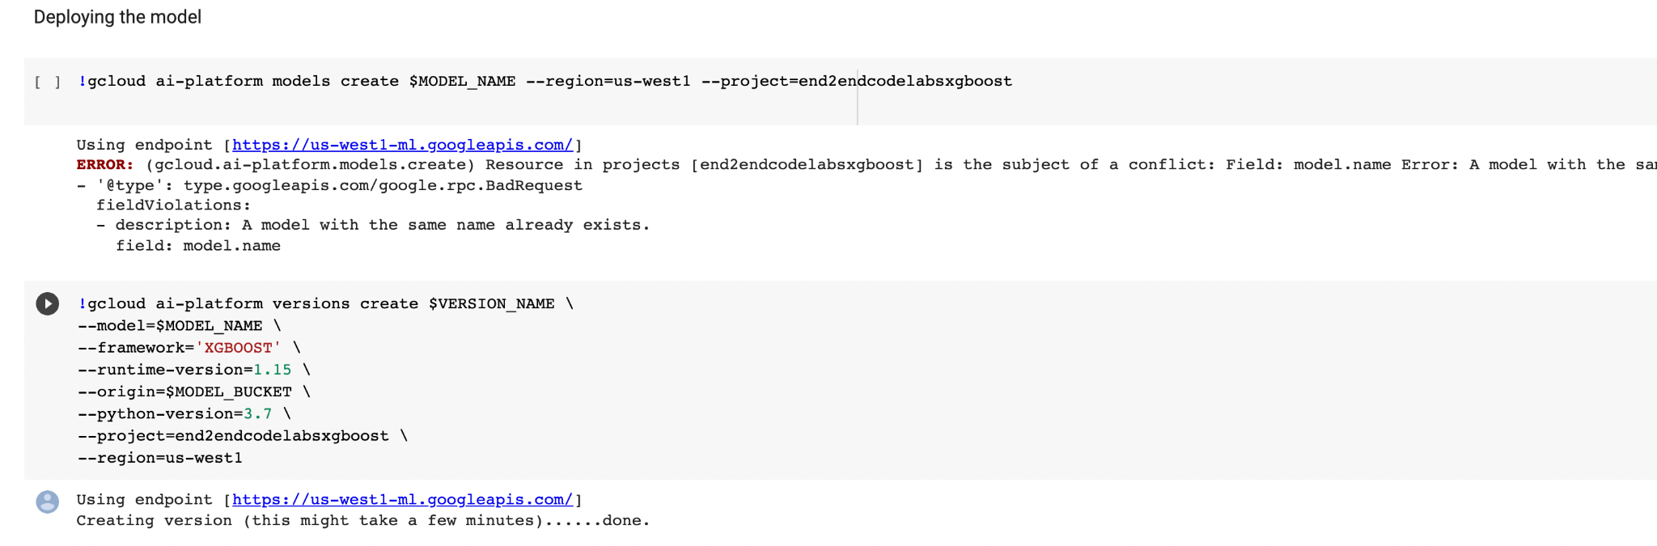
Model Deployment

Slide 12
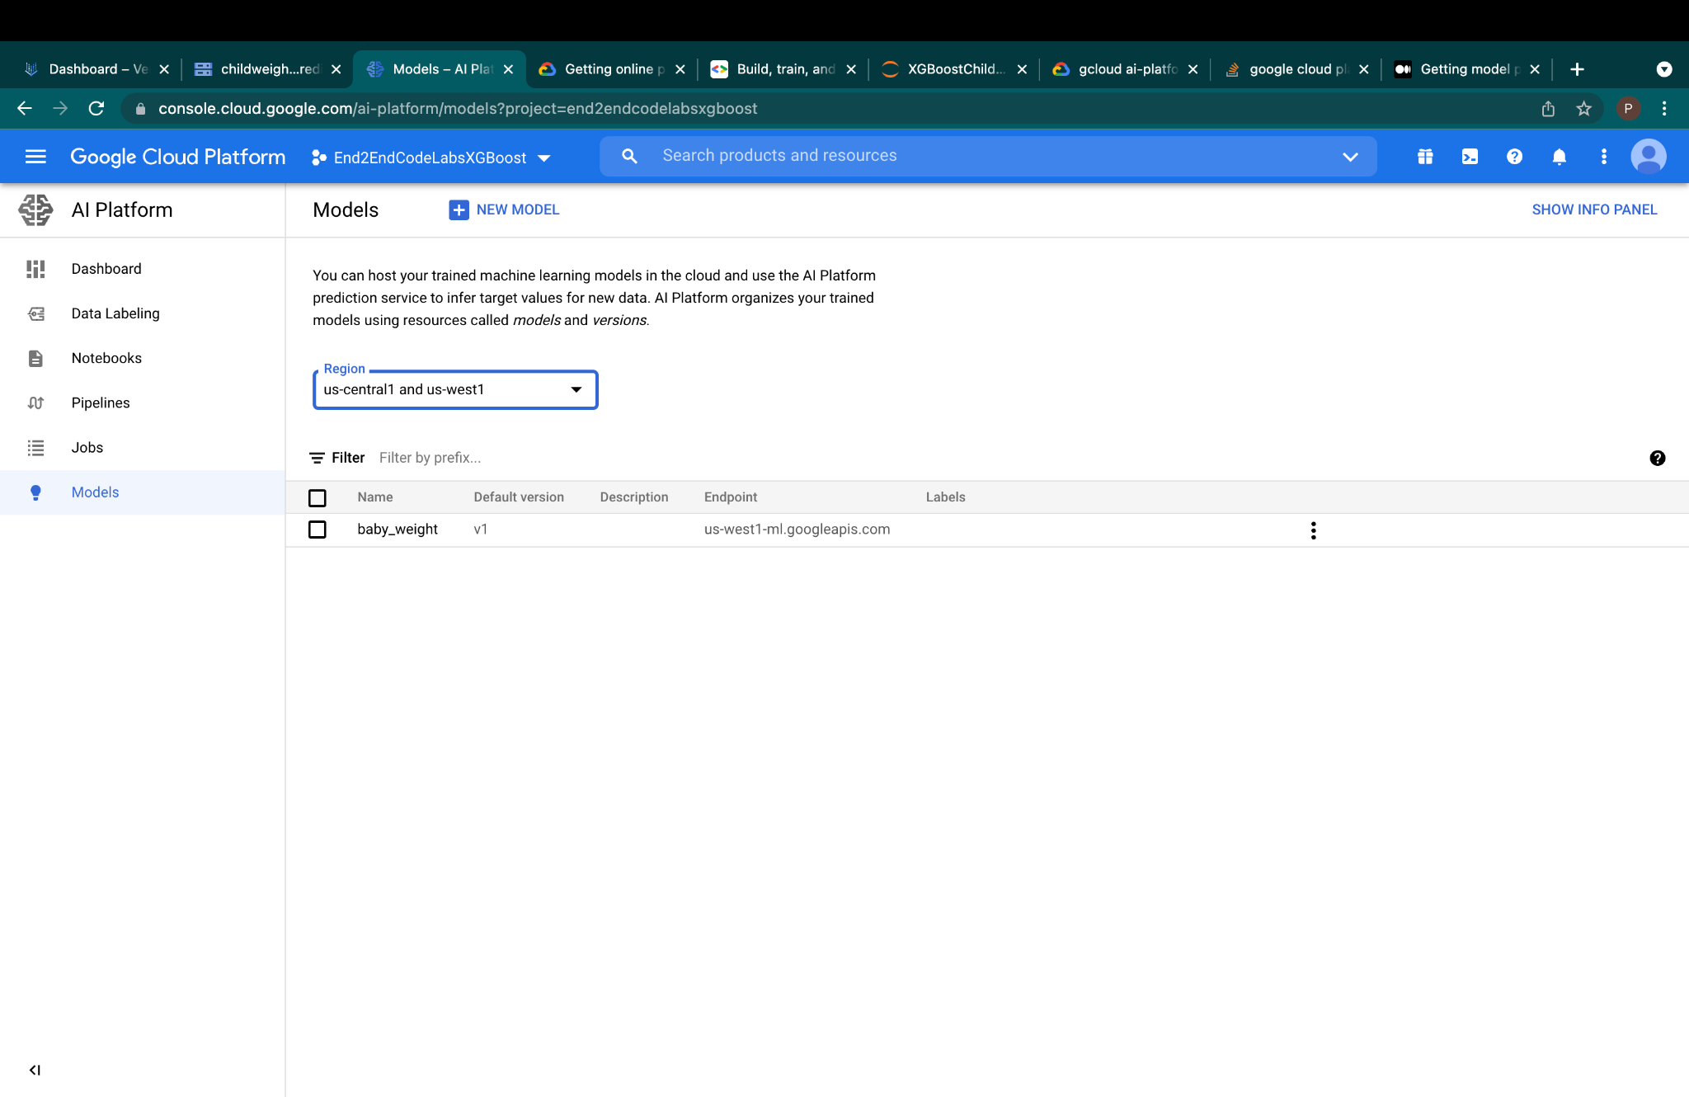
contd:

Slide 13
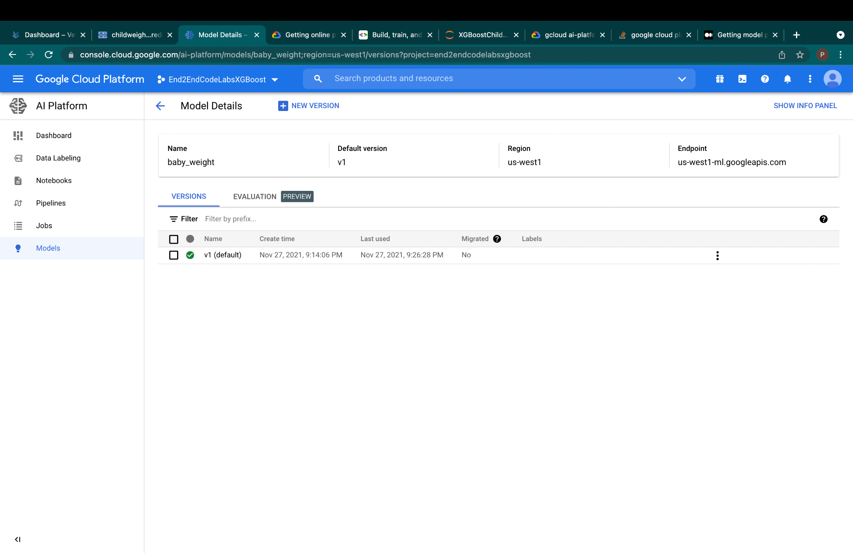
contd:

Slide 14
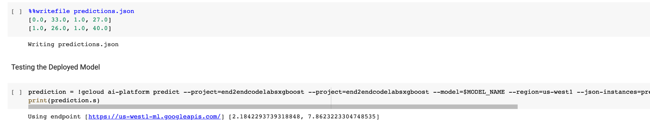
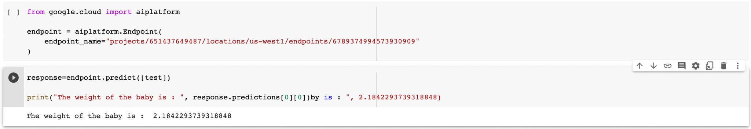
Test the deployed model
Test using the End point

Slide 15
Conclusion
That’s the overall demo of building and deploying of model over GCP
Github Link:
https://github.com/mukkatharun/XGBoostChildWeightPrediction

